Slide 1
Employee Data Analysis using Excel
STUDENT NAME: PAVITHRA.S
REGISTER NO:
DEPARTMENT: B.COM (GENERAL)
COLLEGE: MEENAKSHI COLLEGE FOR WOMEN
5475A1176685424864D498737BE8888B,312208731
1
Notes:
1

Slide 2
PROJECT TITLE
Employee Performance Analysis Based on Pay Zone and Business Status
2

Slide 3


AGENDA
Problem Statement
Project Overview
End Users
Our Solution and Proposition
Dataset Description
Modelling Approach
Results and Discussion
Conclusion
3/21/2024 Annual Review
3

Slide 4

PROBLEM STATEMENT
Pay Zone is a company that provides payment solutions, including point-of-sale services and digital payments. Concerns over profitability, revenue streams, or financial stability.
4

Slide 5

PROJECT OVERVIEW
This overview provides a structured approach to addressing Pay zone’s business challenges and opportunities, aiming for overall improvement in its payment services and operations.
.
5

Slide 6

WHO ARE THE END USERS?
● HUMAN RESOURCE DEPARTMENTS
● MANAGEMENT AND LEADERSHIP
● TEAM LEADERS AND SUPERVISORS
● EMPLOYEES
● EXECUTIVE LEADERSHIP
● BUSINESS ANALYSTS
● RECRUITE
6

Slide 7

OUR SOLUTION AND ITS VALUE PROPOSITION
SOUGHT - REMOVE VALUES
PIVOT TABLE – SUMMARY OF
EMPLOYEE PERFORMANCE
BAR DIAGRAM – FINAL REPORT
7

Slide 8
Dataset Description
● EMPLOYEE DATA SET- NAN MUDHALVAN PORTAL
● 15 FEATURES IN EXCEL:
EMPLOYEE ID- ALPHANUMERIC(TEXT)
NAME- ALPHABETICAL(TEXT)
GENDER- ALPHABETICAL(TEXT)
DEPARTMENT – ALPHABETICAL(TEXT)
SALARY – NUMERICAL
START DATE – ALPHANUMERIC(TEXT)
FTE- NUMERICAL
EMPLOYEE TYPE- ALPHABETICAL(TEXT)
EMPLOYEE LOCATION- ALPHABETICAL(TEXT)
TITLE– ALPHABETICAL(TEXT)
CURRENT EMPLOYEE RATING - NUMERICAL
BUSINESS RATE- ALPHABETICAL(TEXT)
PERFORMANCE RATE –NUMERICAL
PAYZONE – ALPHABETICAL (TEXT)
EMPLOYEE STATUS – ALPHABETICAL (TEXT)

Slide 9

THE "WOW" IN OUR SOLUTION
By implementing such a solution,
Pay zone could significantly enhance
its business status, offering superior payment solutions and achieving remarkable growth and customer satisfaction.
3/21/2024 Annual Review
9

Slide 10
MODELLING
● STEP -1
DOWNLOAD THE EMPLOYEE DATASET
AND OPEN THE EMPLOYEE DATASET IN EXCEL.
● STEP -2
SELECT THE ENTIRE DATA AND CLICK
ON DATA AND CLICK ON FILTER OPTION.
● STEP -3
FILTER FROM A TO Z ORDER.
● STEP -4
SELECT THE ENTIRE DATA AND CLICK
ON INSERT AND CLICK ON PIVOT TABLE TO
CREATE PIVOT TABLE.
10

Slide 11
● STEP -5
DRAG THE NEEDED DATA AND CREATE A
PIVOT TABLE.
● STEP -6
SELECT THE PIVOT TABLE AND CLICK ON
INSERT.
● STEP-7
NOW CLICK ON THE CHART THAT YOU WANT.
● STEP -8
THE CHART IS CREATED.

Slide 12
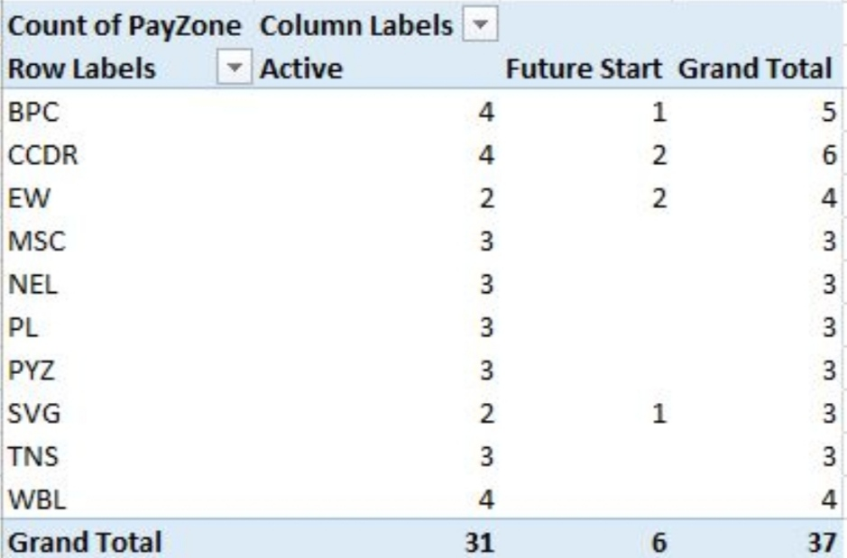
RESULTS
12

Slide 13
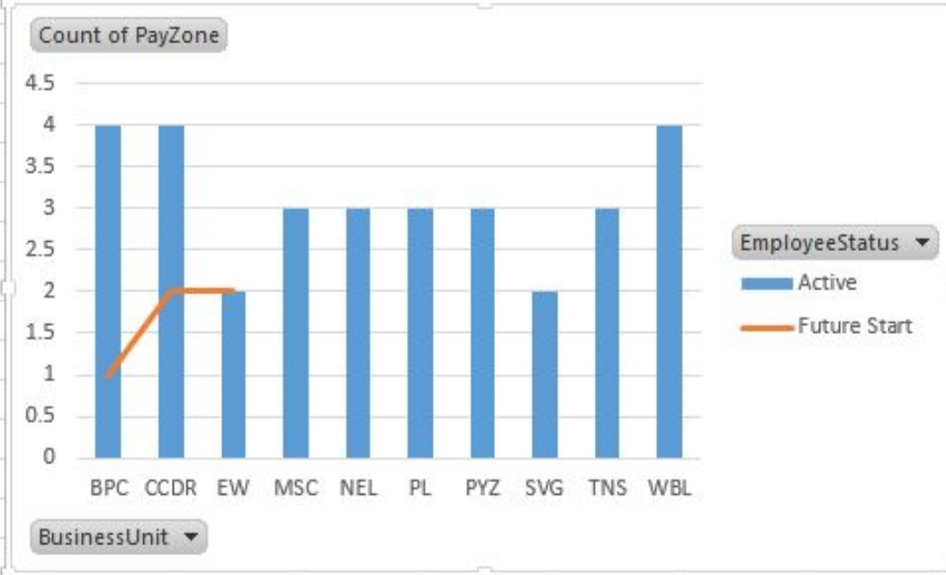
BAR DIAGRAM

Slide 14
conclusion
Employees performance should be evaluated based on how well they contribute to Pay zone’s strategic goals, such as enhancing service offerings, expanding market reach, or improving operational efficiency.
Assess whether employees are meeting or exceeding key performance indicators (KPIs) linked to business objectives.

